Slide 1
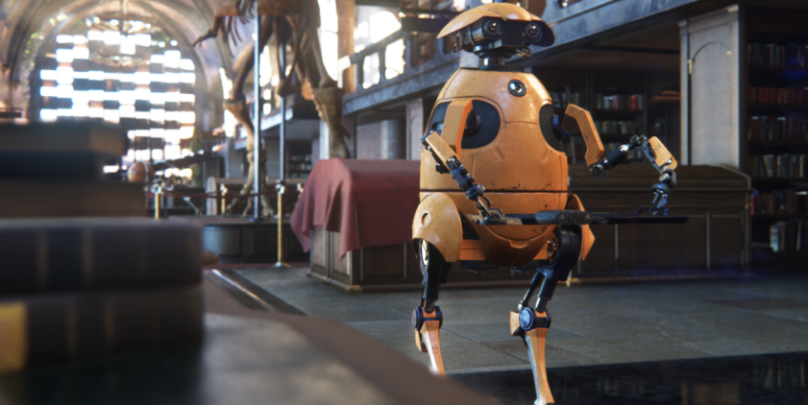
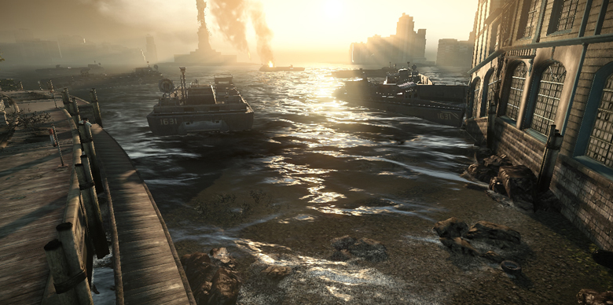
Graphics for Games CPI 411

Slide 2
Introduction
Introduction of Instructor
Course Information
Course Outline
Blackboard System & E-mail
Visual Studio + MonoGame
Student Introduction

Slide 3

Instructor and TA
Instructor: Yoshihiro Kobayashi (YOSHI)
Website: www.yoshikobayashi.com
E-mail: ykobaya@asu.edu
Office Room: BYENG M1-39
Office Hour: T & TH @ 1 – 3PM
It is without any appointment in my office room
TA session : TBA
I will also try to accommodate your requests to meet at a different time if it is more convenient for you
Students prefer to talk to me after class.

Slide 4
Course Information
*) This is available from Blackboard

Slide 5
CPI Programs
CPI 111: 2D Game Development with GameMake
CPI 211: Unity3D
CPI 311: C# & XNA
CPI 321, 421, 422: Art & Design courses
CPI 411, Shader Programming
CPI 412, AI logic Programming
SER (PolyTech) 332, 432, : Unreal 4, WebGL
6 Class (18 units) requires for getting Game Certification.

Slide 6
Course Overview
Tool/Software
Visual Studio 2015/2017 (C#)
Express edition is available for free
You can get the Ultimate edition through ASU
MonoGame 3.6
Game Development Tool/Framework
Textbook
The Cg Tutorial by Nvidia: Available online for free
Other readings provided at the online course page.
Required Items
Notebook for quizzes (a single paper is not allowed)

Slide 7
Teaching Aid
Blackboard (http://myasucourses. asu.edu)
Class Slides
Course Materials
All submissions
Grades

Slide 8
Prerequisite
CPI 311 (C or better grade)
or
Taking/passed CSE 470 / 477 (I will override)

Slide 9
Description
This course is to study coding of real time rendering/shader for games in C# and MonoGame framework. The PC and Visual Studio are required to use any assignments/exercise in this course. By the end of semester, it is expected to have the knowledge and skill set to develop shader tools for game engines such as Unity and Unreal. In other words, the students will study how to implement various vertex and pixel shaders for GPU. The topics covered in this course are listed in the next section.

Slide 10
Learning Objectives
Linear Interpolation (week 1)
Triangles (Interpolation, Rasterization)
Mesh Data Structure Review
Normal Vectors Review (week 2)
HLSL Introduction
HLSL example Shader
A Simple Shading Model ( week 3)
The Direct3D 11 System (week 4)
Environment Mapping (week 5)
Normal Vector Transformations
Bump Mapping
Differential Geometry Review (week 7)
Texturing (week 8)
Shadows (week 9)
Particle Systems (week 10)
Displacement Mapping
Occlusion Culling (week 11)
Shading Pipeline in Valve’s Source Engine
Gamma Correction (week 12)
Motion Blur and Image-based Effects
Tone Mapping (week 13)
Non-photorealistic Rendering
Image-based Post-Processing
Waterflow ( week 14)
Light Propagation Volumes
LODs (week 15)

Slide 11
Instruction Method
This is a hands-on class. Each student has one PC at class.
At class the instructor explains the basic concepts and theory using PowerPoint Slides shown on the projectors, and demonstrates the functions of commands.
The students follow the instructions using their PCs. If they have any question or problem during the instructions, the instructor shows the solutions. For each topic, the students first look at the instructor’s demonstration, and repeat the same thing on their PCs.
The in-class assignment is expected to be finished in the class. But if not, it will be the homework before the next class.
A final project info is announced at 4th week, and the solutions and problems on their final project are discussed at class through the semester. It may be requested to meet individually for catching up with the topics outside of class.
All of the materials using in class are available online at myASU course site.

Slide 12
Attendance Policy
Attendance in this class is mandatory. The attendance is checked in every lecture and lab session.
Not all announcements might be online
In class work will relate to course projects
Assignment requirements will be discussed
Attendance Rate :
More than 90 % of lectures and labs No grade down (1- 2 missing of 3h lectures)
80-90%: One minor grade down (3-4 missing)
70-80%: One major grades down (5 missing)
Less than 70% Not pass (6 or more missing)
We expect the students to maintain atmosphere conducive to teaching and learning in the class. It would be appreciated if all cell phones and pagers were switched off, or to vibrate mode. Active student participation is expected in all in-class discussions.

Slide 13
Assignments
Programming Assignments: Students will be assigned 5 game development assignments. The assignments will test a student’s skill in implementing the concepts discussed in class. These assignments will be implemented in C# with MonoGame framework.
Labs: Each class day has one hour lab session. The students are asked to complete the lab exercise by the end of class and submit the output online.
Quizzes: Student will be assigned small quizzes and/or programming exercise at class.
Term Project: The culmination of the efforts put by the student in the class assignments. The project will have different deliverables over the time frame of the class
Midterm Proposal (9th week)
Final Tool implementation and Demo (15th week)

Slide 14
Evaluation
Four Programming Assignments: 30%
Labs: 30%
Quizzes: 10%
Term Project: 30%
Late Penalty: No late submissions will be accepted

Slide 15
Grading
98+ A+
92 – 98 A
90 – 92 A-
88 – 90 B+
82 – 88 B
80 – 82 B-
70 – 80 C
60 – 70 D
< 60E
I (Incomplete) grade is not offered in this course

Slide 16
Disability Resource Center
Please check the website for ASU’s Disability Resource Center (http://www.asu.edu/drc/) for assistance. Students with special needs should contact the center a priori in order to secure assistance

Slide 17
Academic Integrity
The highest standards of academic integrity are expected of all students. The failure of any student to meet these standards may result in suspension or expulsion from the University or other sanctions as specified in the University Student Academic Integrity Policy. Violations of academic integrity include, but are not limited to, cheating, fabrication, tampering, plagiarism, or facilitating such activities.

Slide 18
Expected Workload
The course is designed to distribute workload pretty evenly over the semester. Students would typically spend 6-9 hours per week working on homework assignments and projects. Plan your schedule accordingly.
Arizona Board of Regents suggests 2- 3 hours outside of class for each hour in class! That means that 6 – 9 hours of work outside of class. If you miss the class you will need more time.

Slide 19
Course Outline

Slide 20
1 | Introduction to the course, Review 3D Game Engine Development
2 | High Level Shader Language (HLSL) Basics Vertex and Pixel Shader | Lab#1
3 | DirectX Pipeline 3D Model | Lab#2
4 | Texturing | Lab#3 | Assignment#1
5 | Environment Map Skybox | Lab#4
6 | Reflection | Lab#5 | Assignment#2
7 | Refraction | Lab#6
8 | Bump Effect | Lab#7 | Assignment#3
9 | Shadow | Lab#8
10 | Particles and Image-based Effects | Lab#9 | Assignment#4
11 | Tone mapping Non Photorealistic Rendering | Lab#10
12-13 | Shader in Unity | Lab#11
14 | Workshop for Final Project
15 | Demos | Grade | Final Project

Slide 21
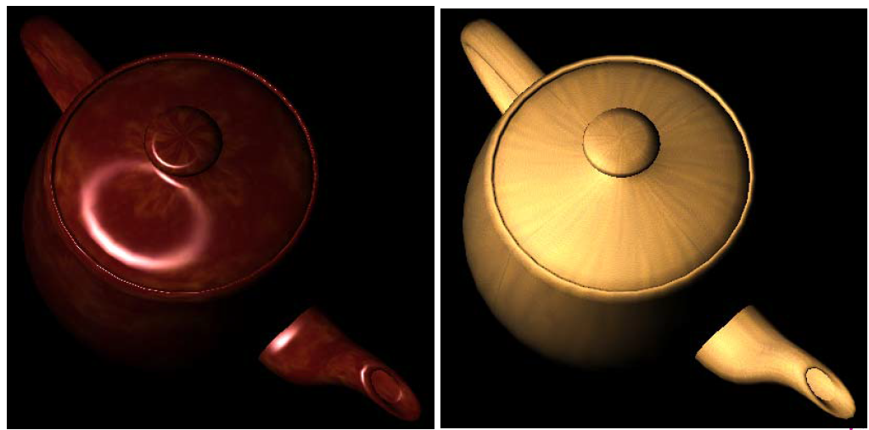
Local Shading Models

Slide 22
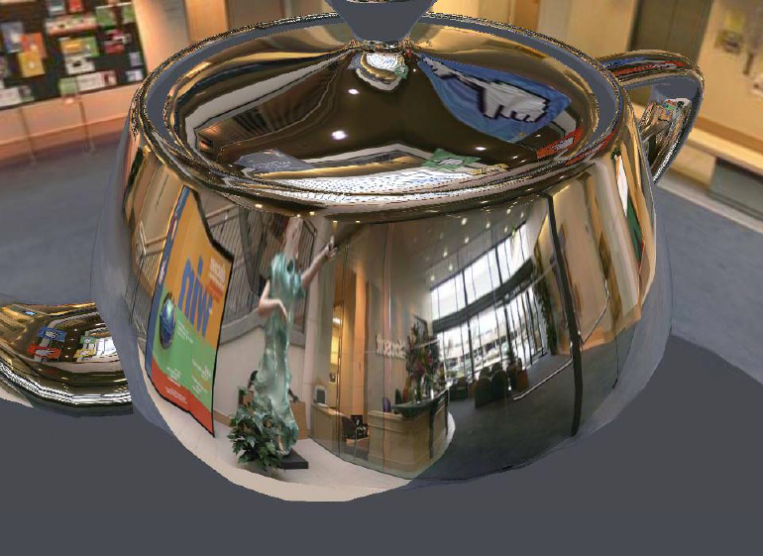
Reflections

Slide 23
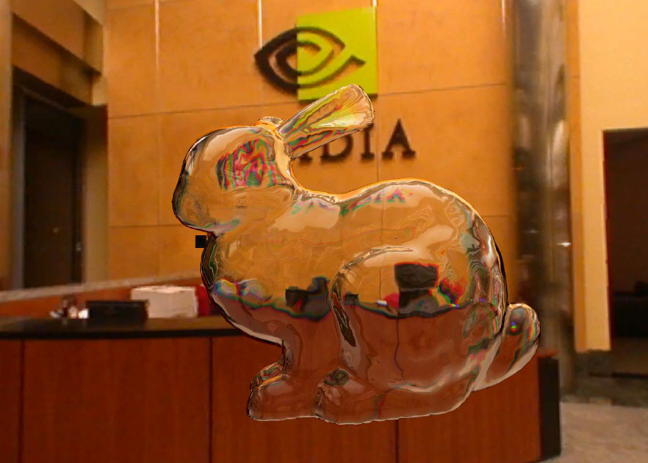
Refractions

Slide 24
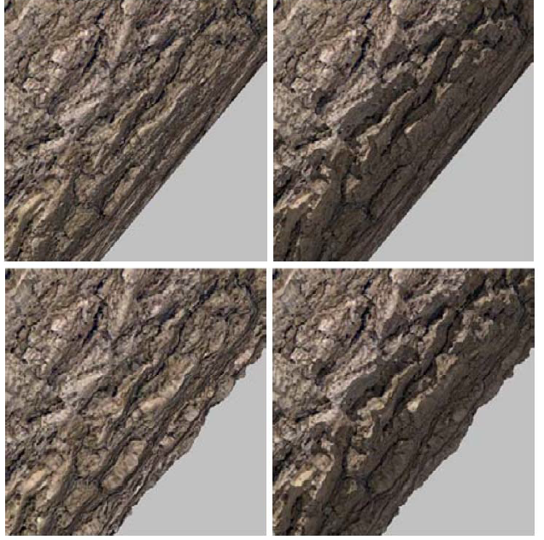
Bump / Displacement Mapping

Slide 25
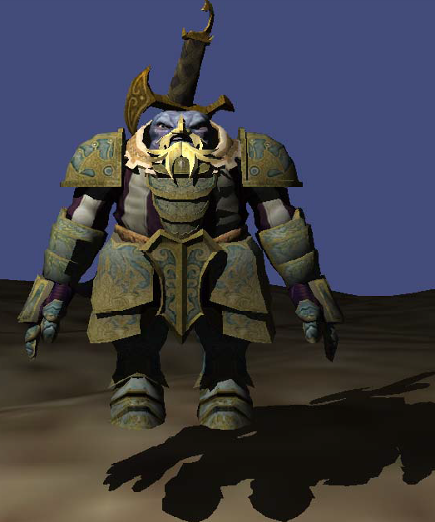
Shadows

Slide 26
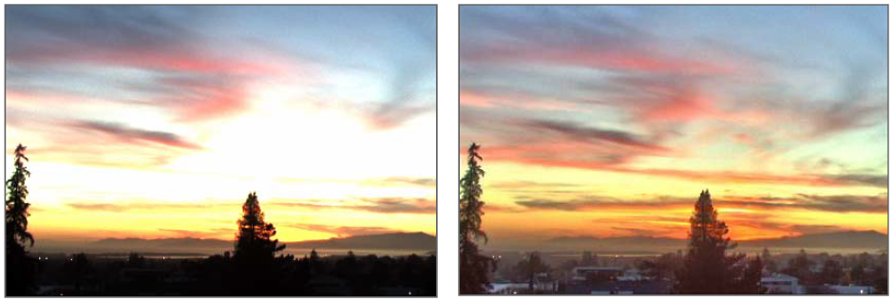
Tone Mapping

Slide 27

Water

Slide 28
Check it out!
1) Check myASU.edu
2) Check if my e-mail reach you or not
3) Tonight, install and set up your home PC
Visual Studio 2017 (Free for ASU students)
MonoGame 3.6

Slide 29
Review

Slide 30
Review CPI311: 3D Math
Vectors and Matrices
Dot and Cross Product
Matrix multiplication
Trigonometry
Quaternion
Different Spaces

Slide 31
Review CPI311 : Programming
The C# Language
Norms and Conventions
Basic constructs, such as Decision Making and Looping
Language specific terms such as Properties, Events, etc.
Object Oriented Principles
Classes and Objects, Inheritance, Interfaces, etc.
Data Structures

Slide 32
Review CPI311 : XNA/MonoGame
Input Handling
Keyboard and Mouse
2D Game Development
Textures, and Fonts, User Interfaces Development
3D Game Development
Models, Transformations,
Other Media
Sounds, Music, Video, etc.

Slide 33
Review CPI311 : Game Development
Collision Detection and Resolution
Also Spatial Sorting
Physics in Games
Lighting and Shading
Mechanics
Interpolation
Terrain Generation from Heightmaps

Slide 34
Review CPI311 : Others
Multi-threading and its uses
Custom effects (High Level Shader Language: HLSL)
Skybox, point-lighting, etc.
Animation
AI (A* Search)
Viewports and resulting ideas

